Slide 1

Temporally Layered Architecture

Slide 2
Asynchronous independent systems
In biology, systems do not differ in response time by a lot.
Sensing is always much faster than processing and actuation. (e.g. event based camera)
Instead of multiple systems with different delays, if we have different independent systems with similar delays acting, we can have a finer control than the delay allows.
Temporal population coding!
Would allow for graceful degradation as we remove systems.
Slow Controller
Slow, Long Action
Fast Controller
Short, Fast
Action
Observation
Environment
Combined
Action

Slide 3


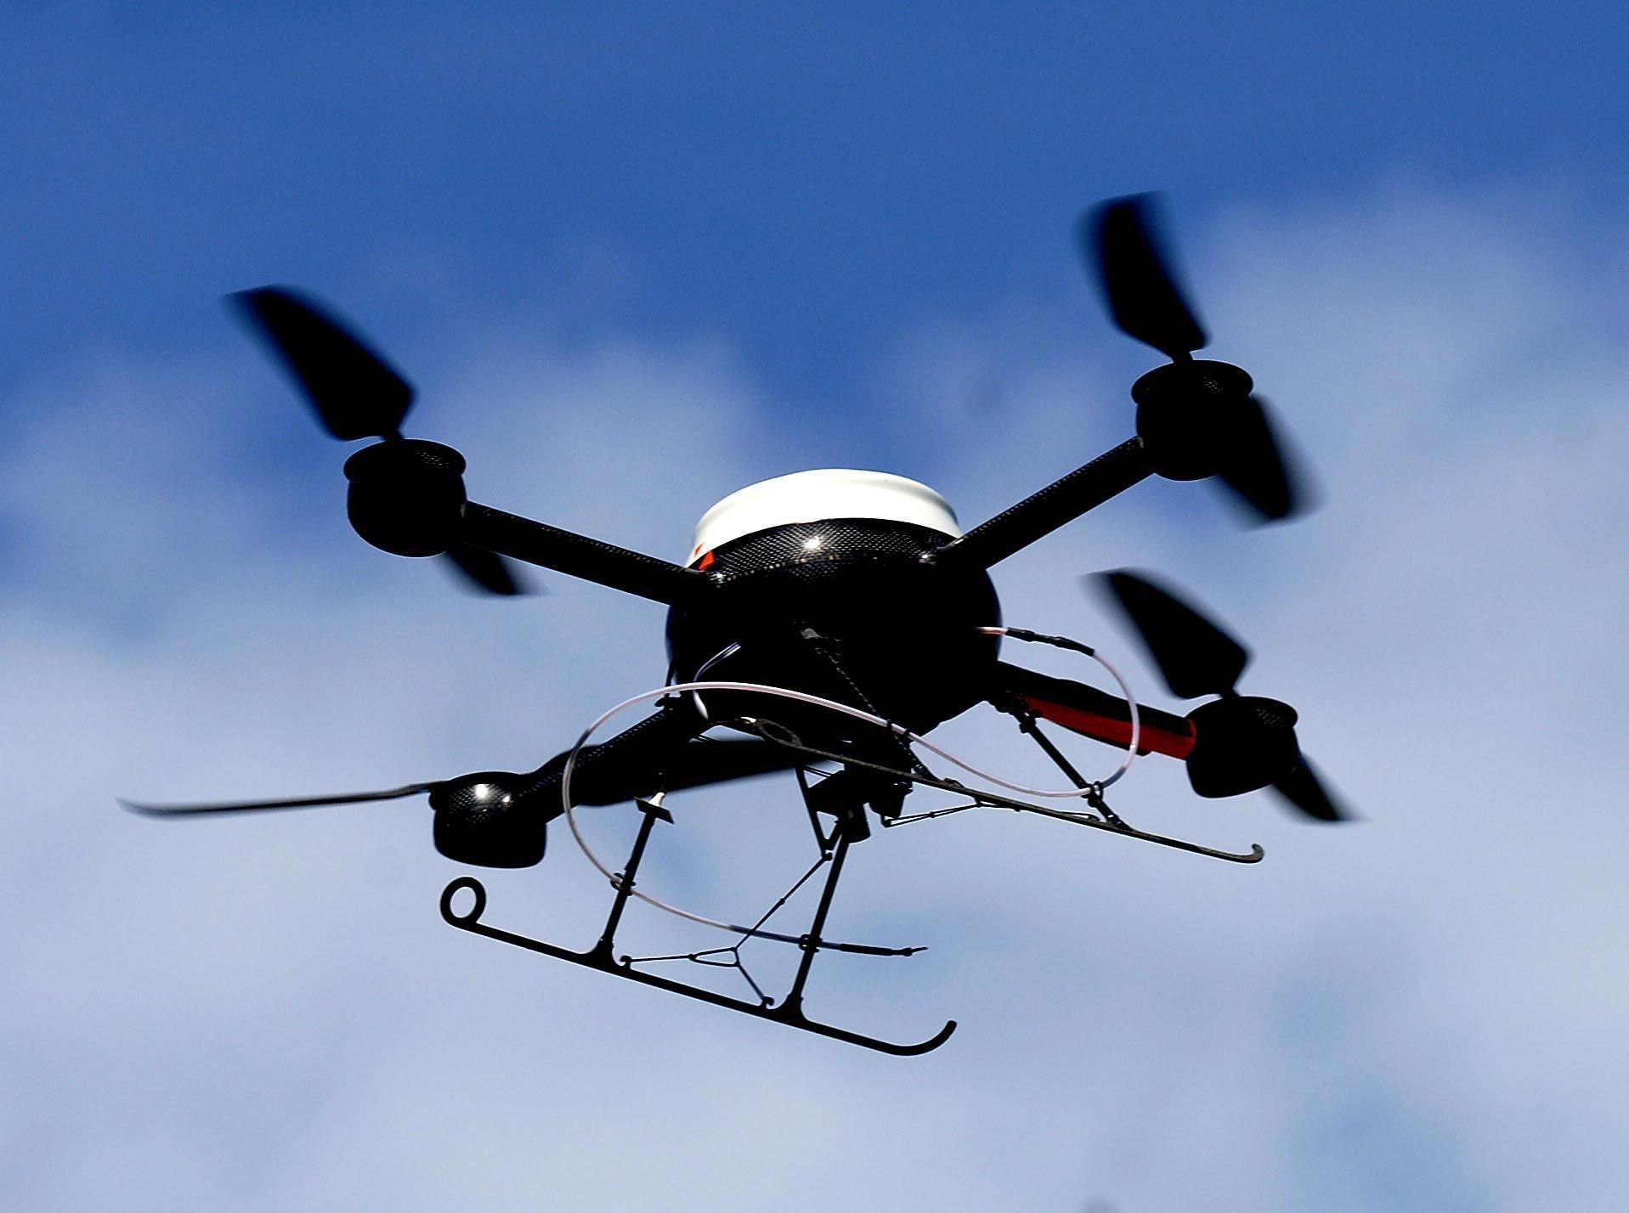
Real world Application
Apply in a real-world architecture with communication delays.
Slow Controller
Slow, Long Action
Balancing and short term goals
Fast Controller
Short, Fast
Action
Observation
Direction and long term goal
Environment
Combined
Action

Slide 4
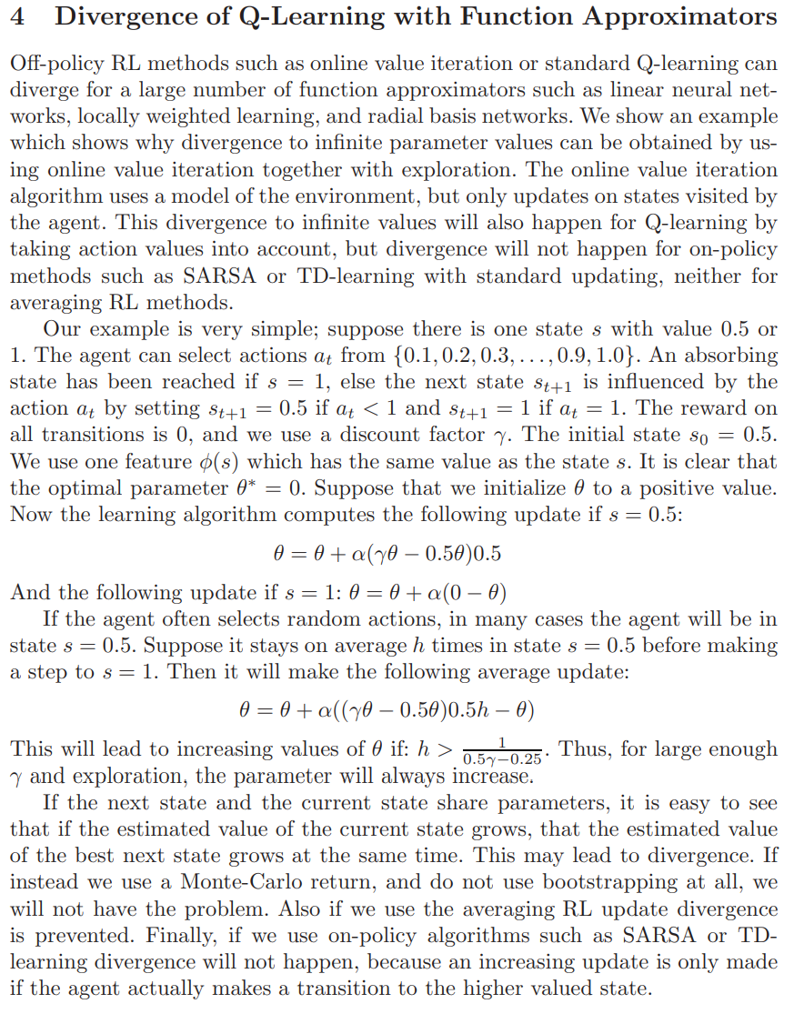
Convergence Guarantee?
This policy can be more difficult or easy depending on conditions. But under some conditions imposed by the parent policy, we can prove convergence?
Slow Controller
Slow, Long Action
Fast Controller
Short, Fast
Action
Observation
Environment
Combined
Action

Slide 5
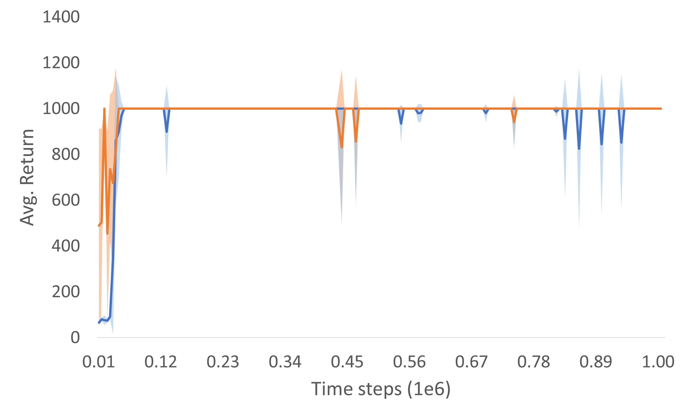
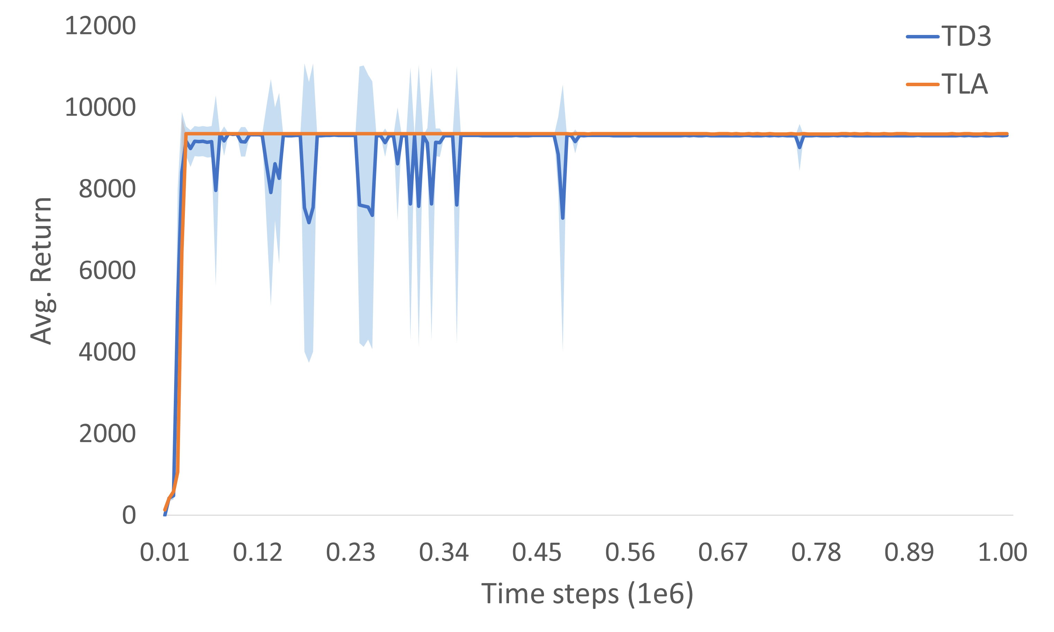
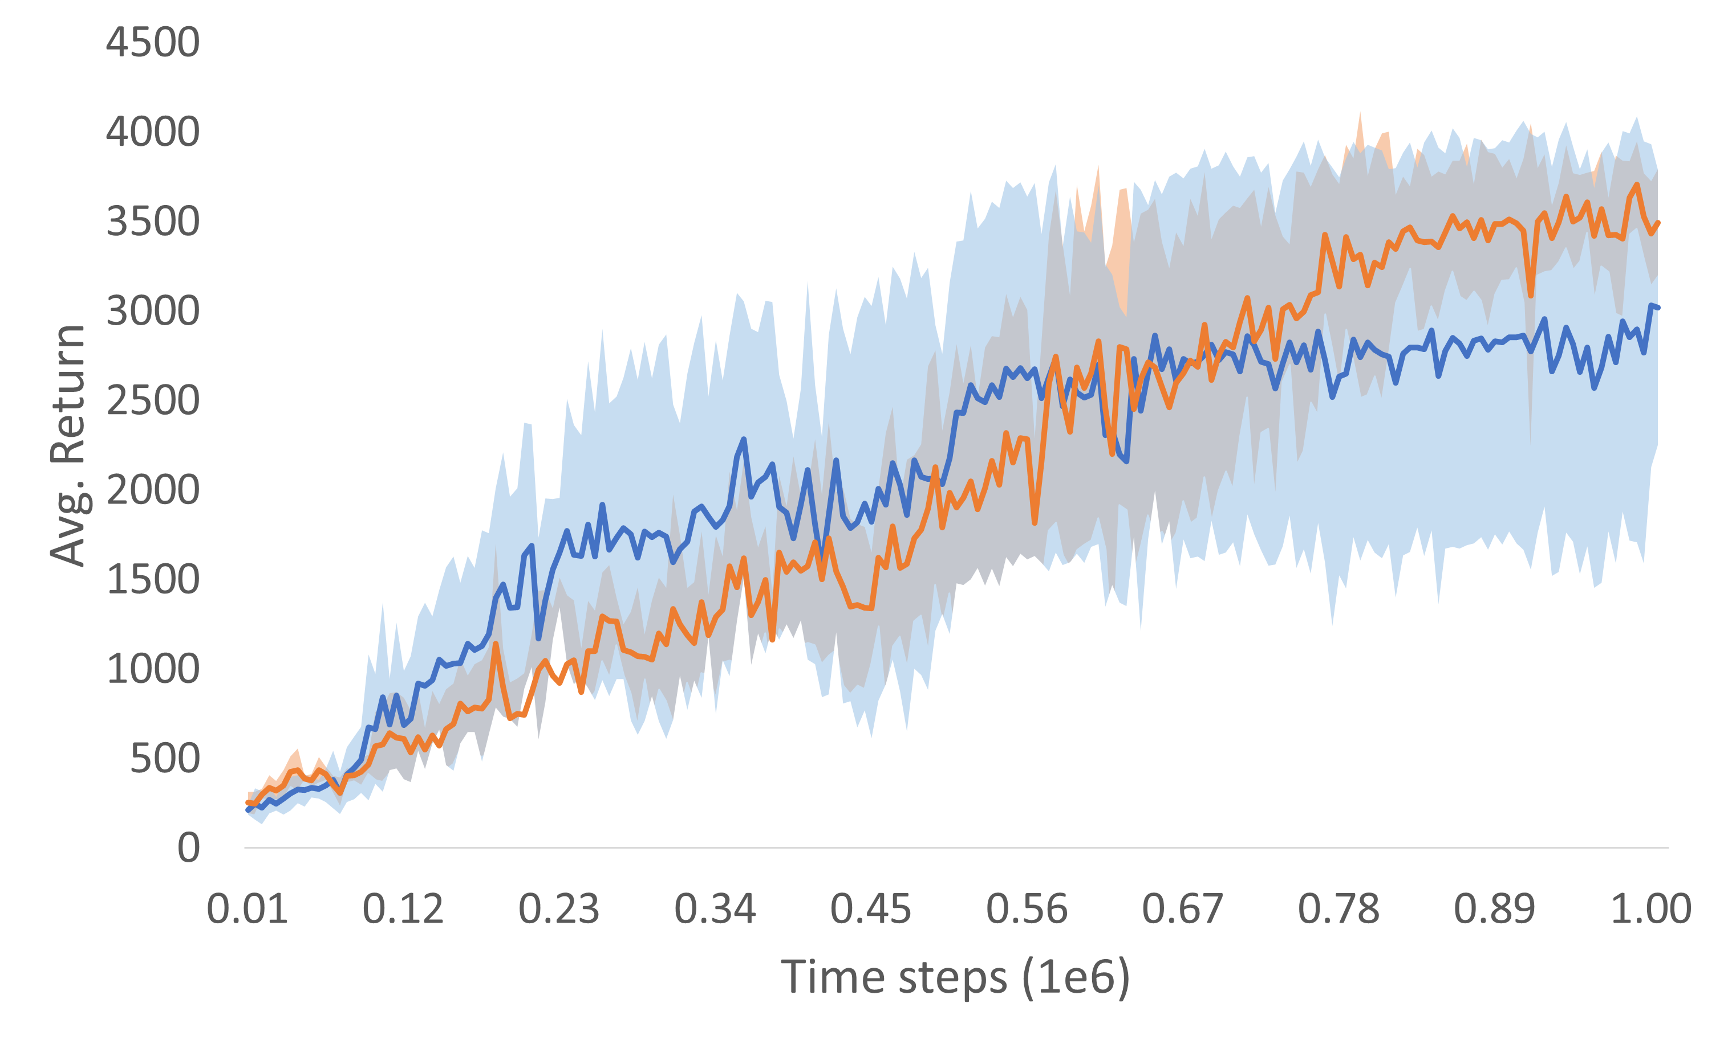
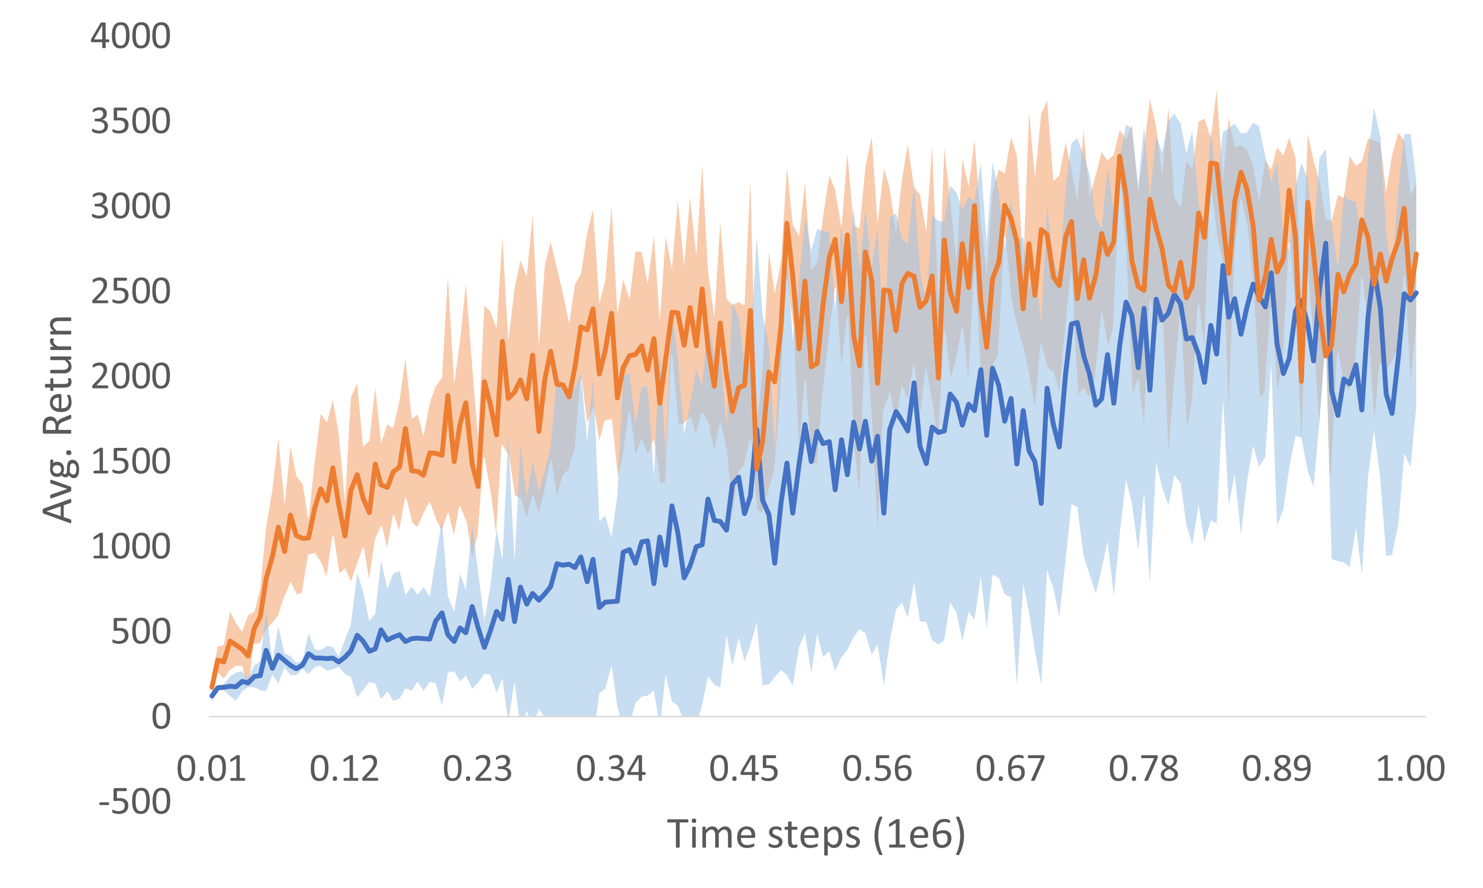
Better Convergence

Slide 6
Control Theory Math?
Slow Controller
Slow, Long Action
Fast Controller
Short, Fast
Action
Observation
Environment
Combined
Action

Slide 7
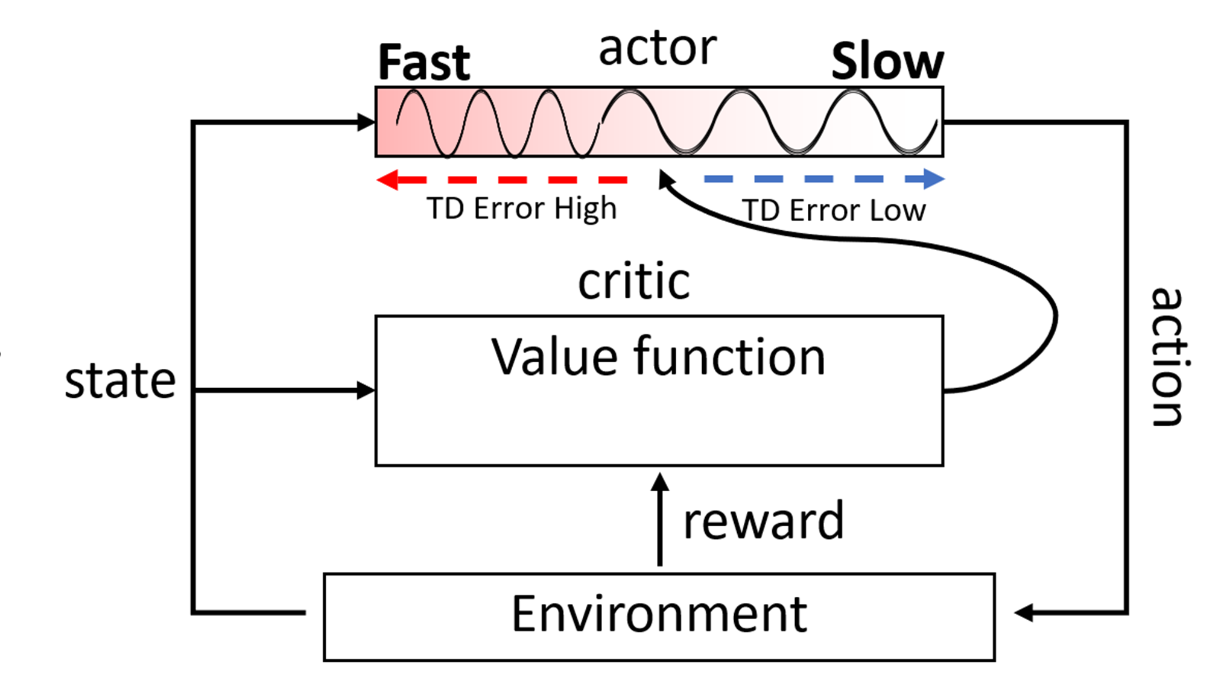
Single adaptive network
Slow Controller
Slow, Long Action
Fast Controller
Short, Fast
Action
Observation
Environment
Combined
Action

Slide 8
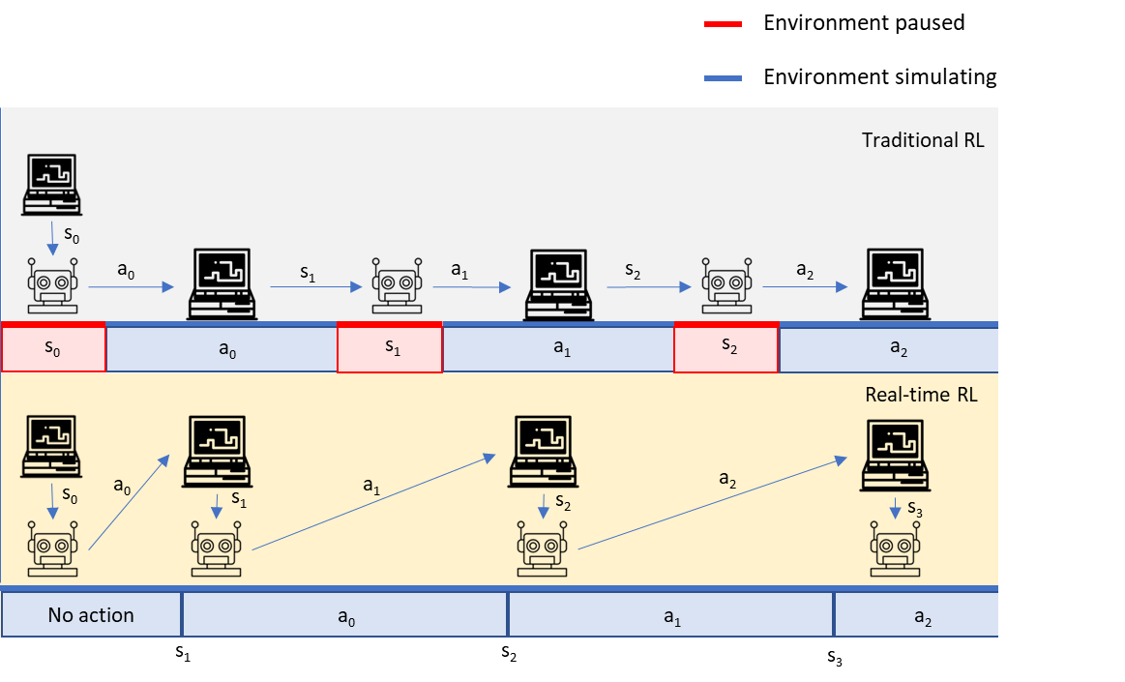
Reflexes / acting in emergency states
Slow Controller
Slow, Long Action
Fast Controller
Short, Fast
Action
Observation
Environment
Combined
Action

Slide 9
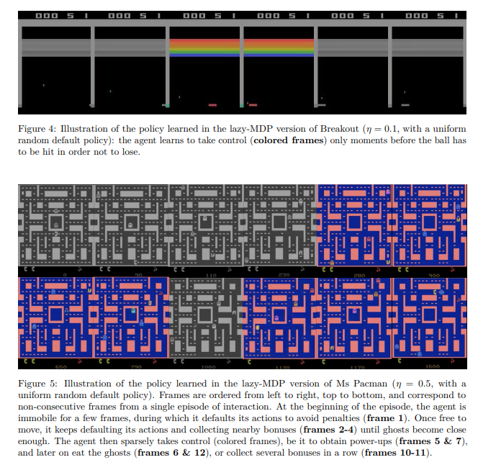
XAI: Temporally important states

Slide 10
Thesis Committee
2 CICS faculty
1 external

